Slide 1
Development of Credit Risk Model for ‘LZ Finance’

Slide 2
Project Overview:
LZ Finance, a Non-Banking Financial Company (NBFC) based in India, has partnered with LIVIS ai, a leading AI service provider, to develop a sophisticated credit risk model.
This model has included a credit scorecard that categorizes loan applications into Poor, Average, Good and Excellent categories based on criteria similar to the CIBIL scoring system
LZ Finance is NBFC(Non-Banking Financial Company) incorporated in 2010.
Success Criteria of developed model:
AUC, Gini > 85
KS statistic > 40
Max KS stat in first 3 deciles
Model interpretation

Slide 3
Why this Project?
As-Is Business Process of Loan approval:
User fill loan application in system.
Underwriter assess application manually.
Underwriter score individual loan application based on business rules.
Underwriter approve or reject Loan application.
To Be Business Process of Loan approval:
User fill Loan application in system.
Model assess application and provide score instantly.
If application is approved by system -Underwriter review application before final sanction of loan.

Slide 4
Business Requirements:
Current Business Problem:
Underwriter takes lot of time to review loan application and sanction loan to customer, loosing opportunities in competitive market.
Application review process is error prone as it involves lot of manual efforts.
The Proposed Solution:
LIVIS ai would like to introduce machine learning model capabilities which will provide instant scorecard for each customer that categorizes loan applications into Poor, Average, Good and Excellent categories based on criteria similar to the CIBIL scoring system.
System Impacted: Nil
Assumptions/Dependencies: Last 5 years Customer Dataset, Loan Dataset and Bureau Dataset is required for each customer
Business requirements:
Phase 1: Development and Implementation
Model Development: Build a predictive model using LZ Finance’s dataset which includes historical loan data and default indicators.
Scorecard Creation: Develop a scoring system that categorizes credit scores into Poor, Average, Good, and Excellent.
Streamlit UI Application: Develop a user-friendly interface where loan officers can input borrower demographics, loan details and bureau information (such as credit utilization and open accounts) to obtain predictions on default probabilities and credit ratings.

Slide 5
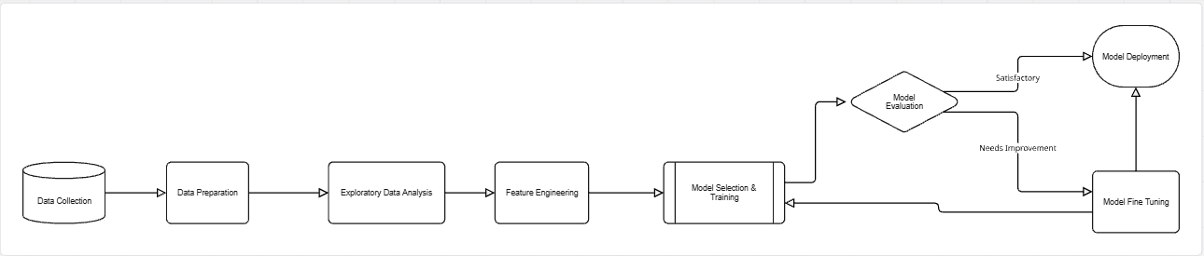
Modelling steps (High Level Architecture):

Slide 6
Data SOURCE
Source: Past Five year’s data from LZ Finance
Feb 2022 to Feb 2024
Mar 2024 to May 2024
Training and Validation
Out of Time

Slide 7
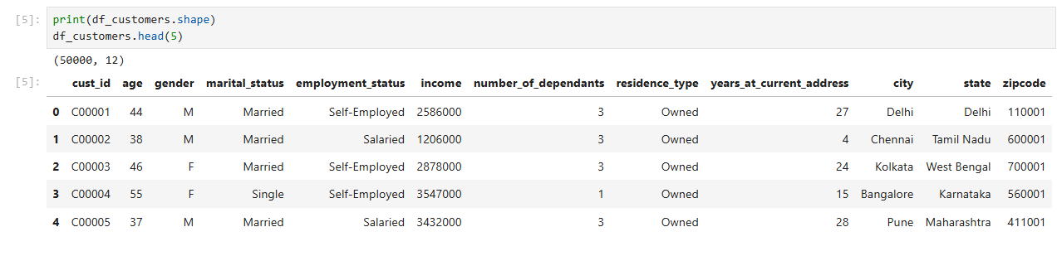
Data collection 1: Customer Dataset

Slide 8
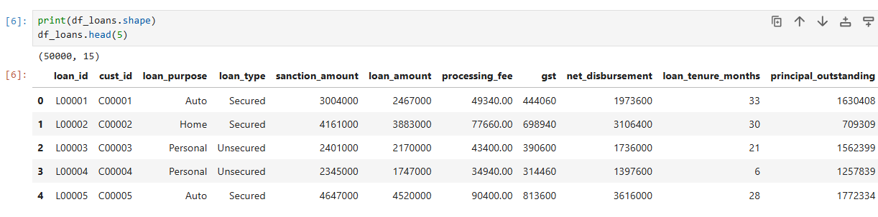
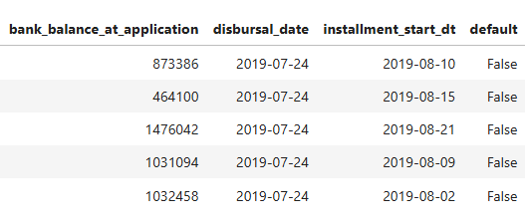
Data collection 1i: Loan Dataset
Copyright by LIVIS AI 20-09-2025

Slide 9
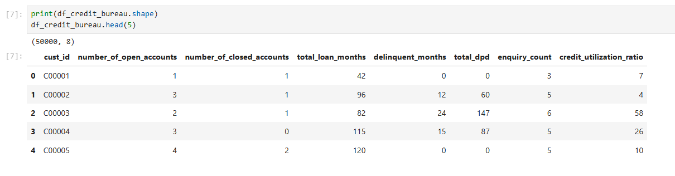
Data collection iii: Bureau Dataset

Slide 10
Data Preparation & EXPLORATORY DATA ANALYSIS:
Load Data
Merge Data
Train-Test Split
Data Cleaning : Handle missing and duplicate value
EDA: Age column
Analyze Categorical Columns
Outlier Handling: Outlier Treatment
Outlier Handling: Outlier Identification using Box plot
EDA: Plot KDE for all columns

Slide 11
FEATURE ENGINEERING& feature selection
Generate Feature: Loan to income ratio
Generate Feature: Delinquency Ratio
Generate Feature: Average DPD per delinquency
Feature Selection for Numerical columns :Variance Inflation factor(VIF)
Remove columns which business contact person asked us to remove
Remove columns which are just unique ID and have no influence on target variable
Feature Selection for Categorical columns :WOE and IV
Feature encoding

Slide 12
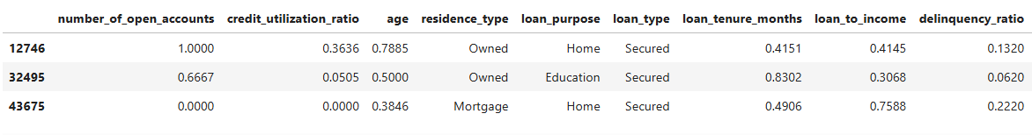
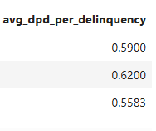
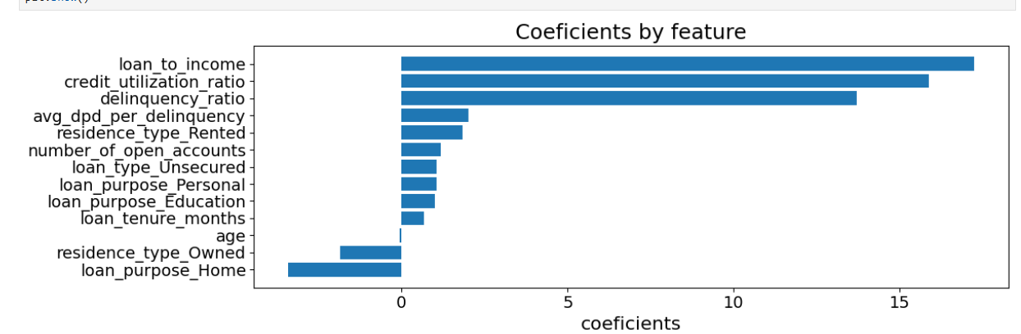
FINAL SELECTED FEATURES & FEATURE IMPORTANCE
Copyright by LIVIS AI 20-09-2025

Slide 13
Model Training& Fine TUNING
Attempt no. | Model Description | Remarks
Attempt 1 | Logistic Regression, Random Forest and XGB | No Handling of class imbalance
Attempt 2 | Logistic Regression | Handle class imbalance using Under sampling
Attempt 3 | Logistic Regression | -Handle Class imbalance using SMOTE Tomek -Parameters tuning using Optuna
Attempt 4 | XGBoost | -Handle Class Imbalance using SMOTE TOMEK -Parameter tuning using Optuna

Slide 14
Model Evaluation
Model evaluation : ROC/AUC Curve
Model evaluation : Rank Ordering, KS statistics and Gini coefficient
Copyright by LIVIS AI 20-09-2025

Slide 15
Trail and Performance
Model | AUC | GINI
Logistic Regression | 98 | 96
XGBoost | 99 | 96
Random Forest | 97 | 95

Slide 16
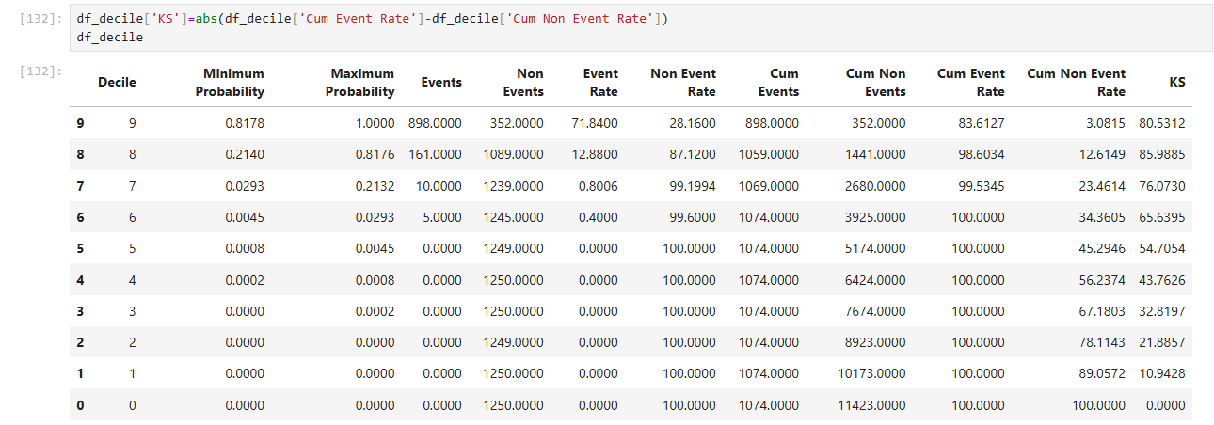
MODEL EVALUATION:
AUC | GINI | Top 3 decile capture rate
98% | 96% | 99.5345%
Copyright by LIVIS AI 20-09-2025

Slide 17
Thank You

